Slide 1


Slide 2

Use any one method, or a combination of methods, to introduce your topic to reader in an interesting way:
1.General to narrow
2.Starting with an opposite
3.Stating importance of topic
4.Incident or story
5.Question
6.Quotation

Slide 3

1. General to narrow
Bookstore shelves today are crammed with dozens of different diet books. The American public seems willing to try any sort of diet, especially the ones that promise instant, miraculous results. And authors are more than willing to invent new fad diets to cash in on this craze. Unfortunately, some of these fad diets are ineffective or even unsafe. One of the worst fad diets is the “Palm Beach". It is impractical, doesn’t achieve the results it claims, and is a sure route to poor nutrition

Slide 4
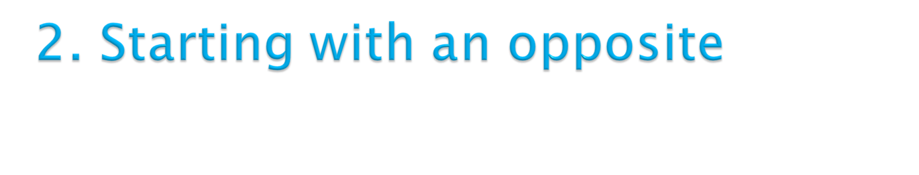
When I decided to return to school at age thirty-five,I wasn’t at all worried about t my abilities to do the work. After all, I was grown woman who had raised a family, not a confused teenager fresh out of high school. But when I started classes, I realized that those ‘ confused teenagers” sitting around me were in much better shape for college than I was. They still had all their classroom skills in bright, shiny condition , while mine has grown rusty from disuse. I had to learn how to locate information in a library, how to write a report, and even how to speak up in the class discussions.

Slide 5

Diseases like whooping cough and scarlet fever used to kill more young children than any other cause. Today, however, child mortality due to disease has been almost completely eliminated by medical science. Instead, car accidents are number one killer of our children. And most of the children fatally injured in car accidents were not protected by car seats, belts, or restrains of any kind. Several steps must be taken to reduce the serious dangers car accidents pose to our children.

Slide 6

Early Sunday morning the young mother dressed her little girl warmly and gave her candy bar, a picture book and a well worn stuffed rabbit. Together, they drove downtown to a Methodist Church. There the mother told the little girl to wait on the stone steps until children began arriving for Sunday school. Then the young mother drove off, abandoning her five year old because she couldn't cope with being a parent anymore. This incident is one of thousands of cases of child neglect and abuse that occur annually. Perhaps the automatic right to become a parent should no longer exist. Would-be parents should be forced to apply for parental license for which they would have to meet their important conditions.

Slide 7
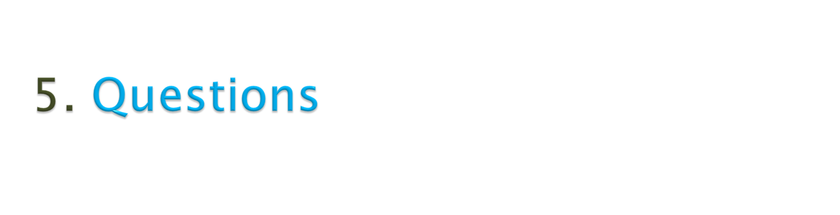
What is love? How do we know that we are really in love? When we meet that special person, how can we tell that our feelings are genuine and not merely infatuation? And, if they are genuine , will these feelings last? Love, as we all know, is difficult to define. But most people agree that true and lasting love involves far more than mere attraction. Love involves mutual respect, the desire to give rather than take, and the feeling of being wholly at ease.

Slide 8

“ Fish and visitors”, wrote Benjamin Franklin, “ begin to smell after three days”. Last summer, when my sister and her family came to spend their two- week vacation with us, I became convince that Franklin was right. ……………………..

